Slide 1

Matthew Manuel, Thien Hua, Leon Lin, Ramon Santos

Slide 2
Intro: Deliverable
Dataset was taken from airsofia, a website that tracks air quality
Was made in response to Bulgaria for failing to implement significant anti-pollution measures
Gives location coordinates, air quality (pressure, temperature, humidity) and timeframe

Slide 3
Background
2013 Sofia was singled out for a study by the European Environment Agency
This was due to Sofia’s presence of several air pollutants in the atmosphere
Caused by gas and carbon monoxide from burning wood and coal.

Slide 4
Background (cont)
Natural factors to air pollution
Geographic location
Stagnation of air
Human activity is the main source
Transportation with the use of diesel
Old heating system

Slide 5
Background Cont.
Two groundbreaking decisions made
Jnecek Case
ClientEarth Case
These decisions allowed
The Right of Standing
The Right of Legal Remedy
The Right to a Substantive Review

Slide 6
Related Work
European Environment Agency in 2013
World Health Organization in 2016
Both studies focus on the rampant spread of air pollution
We used big data obtained from a data source from an agency that tracks down air quality.
Focus on temperature of a specific region and noting changes in values over time

Slide 7
Specifications
Cluster version 6.1 (includes Apache Spark 2.4.4, Scala 2.11)
Number of nodes: 1
Memory size: 2.7 GB
Cpu speed: 2.30 GHz

Slide 8
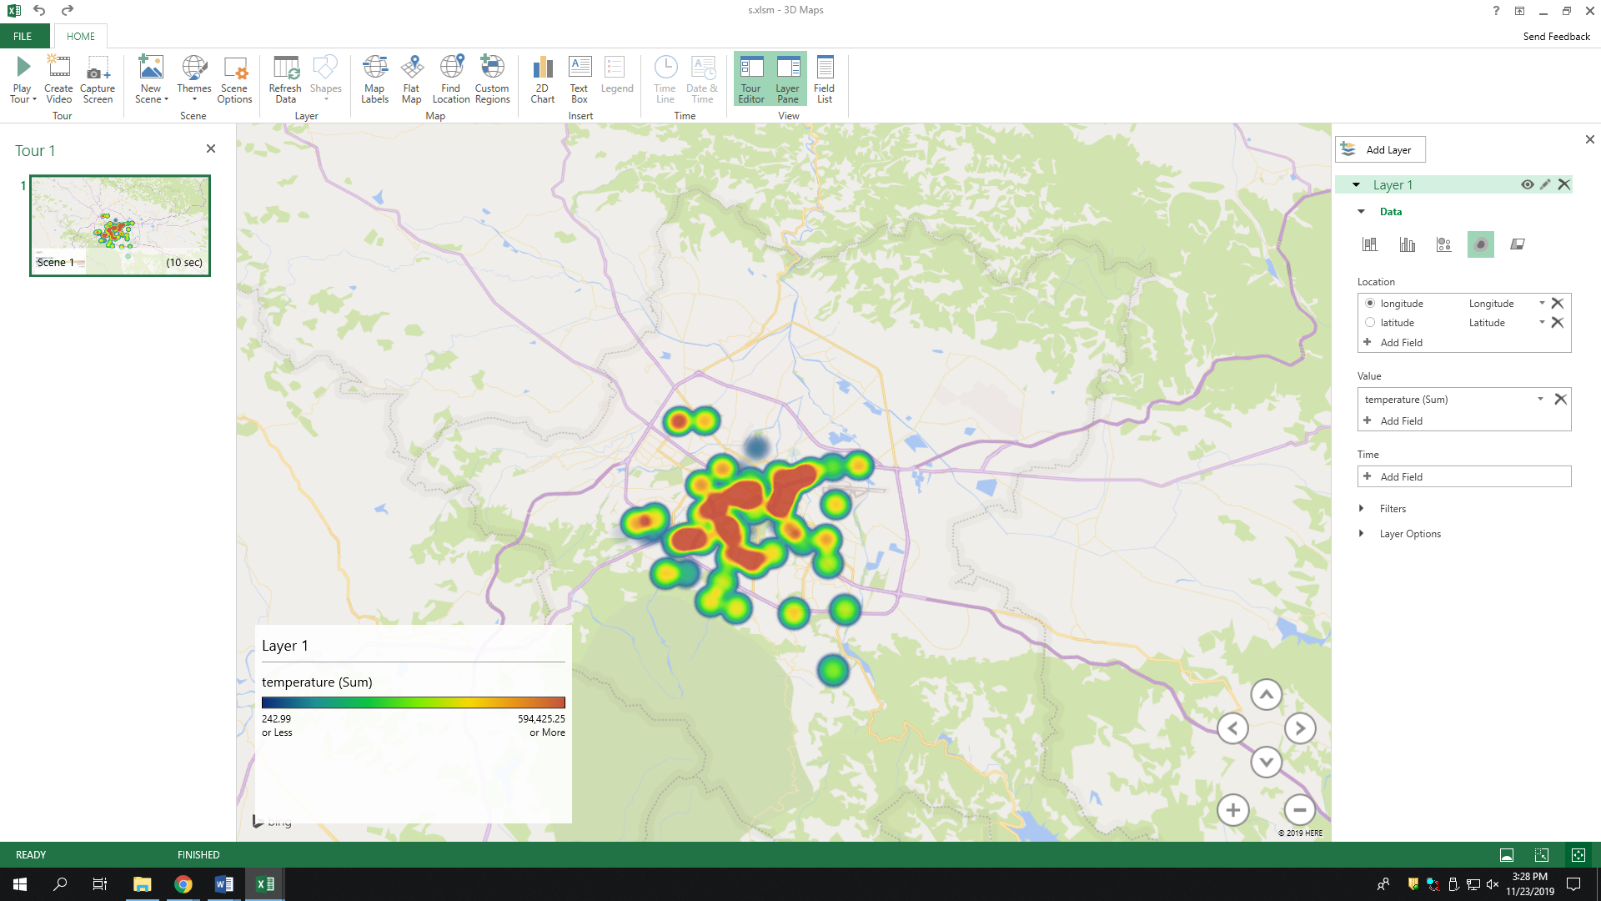
Our Work
Temperatures in a specific location due to air quality

Slide 9
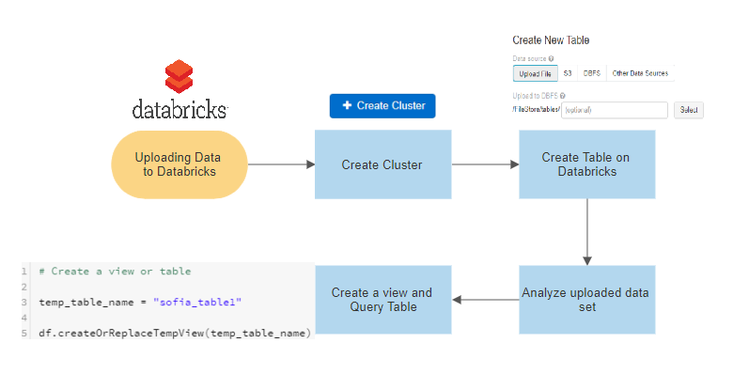
Data Flow Chart

Slide 10
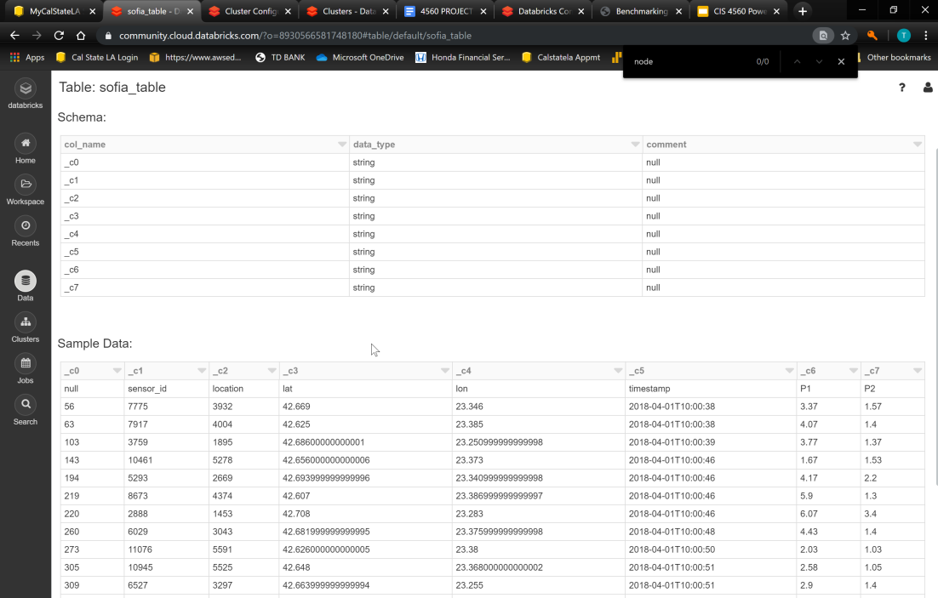

Slide 11
Data Url
Data Size: 14 GB
https://www.kaggle.com/hmavrodiev/sofia-air-quality-dataset

